Slide 1
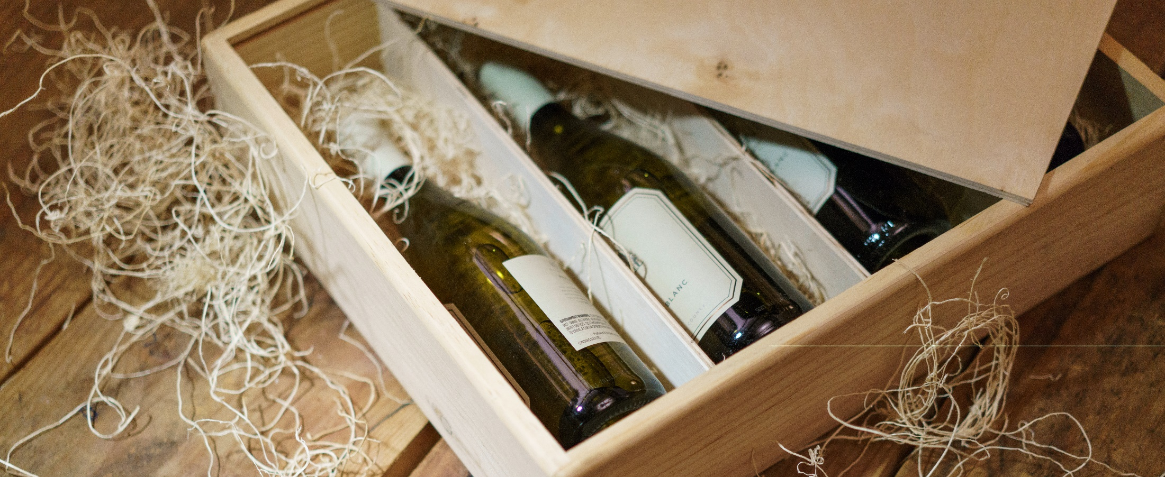
Wine, a matter of chemicals?
Group 2

Slide 2
Agenda
Application Area & Goals
Dataset
Approaches
Naive Bayes
kNN
Decision Trees
Support Vector Machines
Feed-forward Neural Networks
Best results over all approaches
Discussion

Slide 3
Application Area & Goals
Predict quality of Vino Verde (red and white)
Only given the chemical values
Differentiate between good, avarage and bad wine
get an impression what attributes are important for red or white wine

Slide 4
Dataset
1599 red wines
4898 white wines
Attributes:

Slide 5
Different Approaches
Jeder nur eine Slide für seinen Approach!!!!!!

Slide 6
Naive Bayes

Slide 7
kNN

Slide 8
Decision Trees

Slide 9
Support Vector Machines

Slide 10
Feed-Forward Neural Networks

Slide 11
Best Results over all Approaches
Tabelle mit den besten Ergebnissen pro Ansatz

Slide 12
Discussion
Mögliche Erklärungsansätze

